Slide 1
“Coming from the world of comedy, I’ve told and written a lot of jokes that I once thought were funny but later came to realize were just plain offensive. But the intentions behind my actions aren’t the point at all. It’s the impact these jokes had on others that matters. And I’m sorry it’s taken me so long to come to terms with that.”
- Al Franken

Slide 2
Notes:
Macomb County has made a lot of news lately. A northern suburb of Detroit, the county is largely ‘blue collar’ and its economy is heavily dependent upon the auto industry. Last week Macomb County voted decisively for Donald Trump. It was the first time in almost thirty years that a Republican presidential candidate has carried Michigan

Slide 3
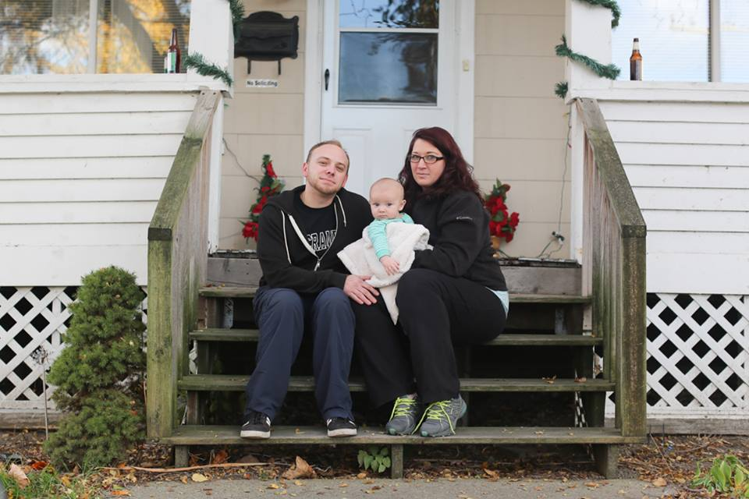
I think a lot of people live on the borderline of racism. I work in a machine shop with about thirty older guys. I don’t think there is one bad guy in the group. You’d like them if you met them. All of them love their families. But I’d say that I’ve heard eighty percent of them make racist comments of some sort. A lot of the older guys drop ‘n bombs.’ But if a black guy walks up, they’ll be friendly. They’ll even go out to lunch with him and share a meal. I honestly don’t think they see themselves as
racist. Every one of them will
deny it. They’ll point to the
black guy that they’re
friendly with. They won't
point to the things they say
when he’s not around.

Slide 4
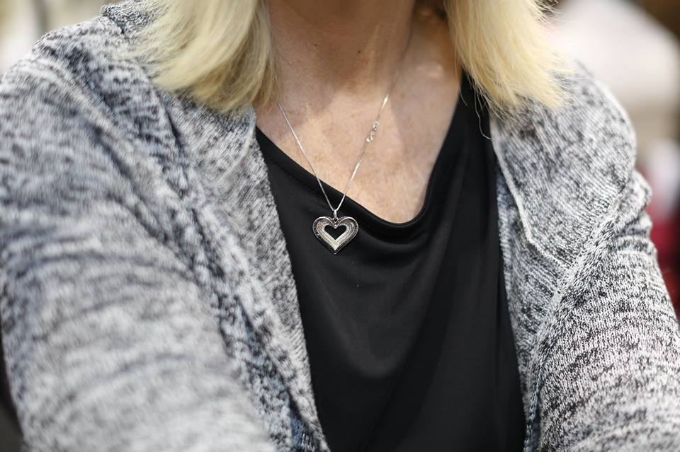
Don’t get me wrong. I want everyone to get along. And I don’t want to sound racist. But they’re coming into our country. If you ask me, that makes them racist. There’s something going on with the Muslims. There’s something going on there. There’s a lot we don’t know about. They have a game plan. They want all the businesses. They
want control. They want
my grandchildren to
work for them. I’m
hoping he can do some-
thing about it. We need
somebody to say no.

Slide 5
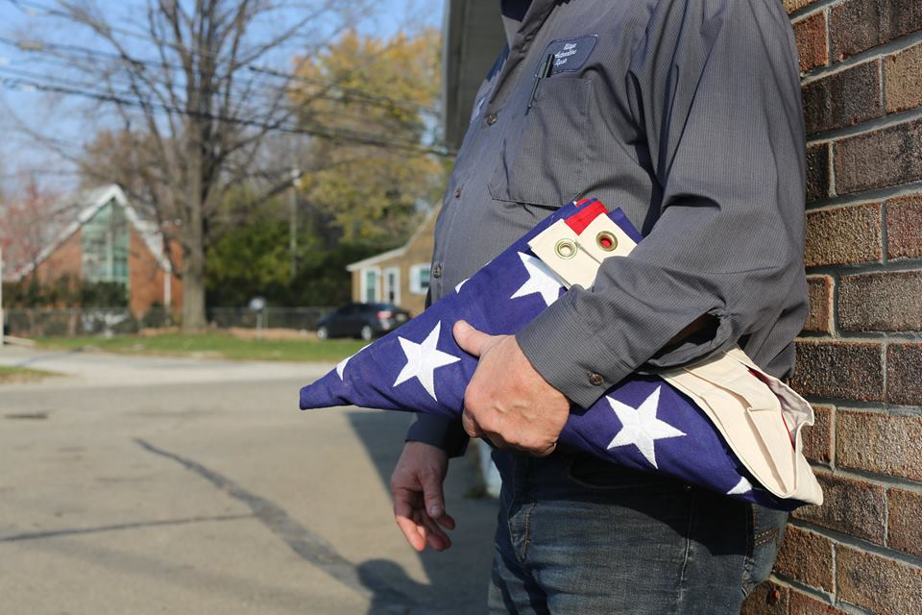
This racial stuff to me is BS and I’m
tired of hearing it. I have it made
because I’m a white male? I’m
prejudiced? That shit is long ago.
Way long ago. Enough of it. It’s all
the media. It’s all for ratings. It’s this false racial shit that they keep pumping into everybody’s head. They’re keeping everyone on edge. If there’s a police shooting—it’s white versus black. Always white versus black. Who cares about the facts? Race is more important. Watching the news, you’d think there was a race war out there. But then I walk outside and I just don’t see it. I hold the door for the black guy. He holds the door for me. I wouldn’t even know there was a problem if it wasn’t for the television. They need to quit making shit out of nothing.

Slide 6
Impact > Intent

Slide 7
Explain the IMPACT of the three statements on you and your peers.
Evaluate what specifically caused that IMPACT.

Slide 8
Explain Naylor’s INTENT in “The Meaning of the Word.”
Identify the evidence that you used to determine INTENT.

Slide 9
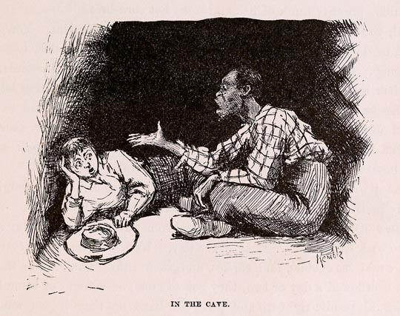
219

Slide 10
Where do you see the effects of
Impact > Intent
on our understanding of racism today?

Slide 12
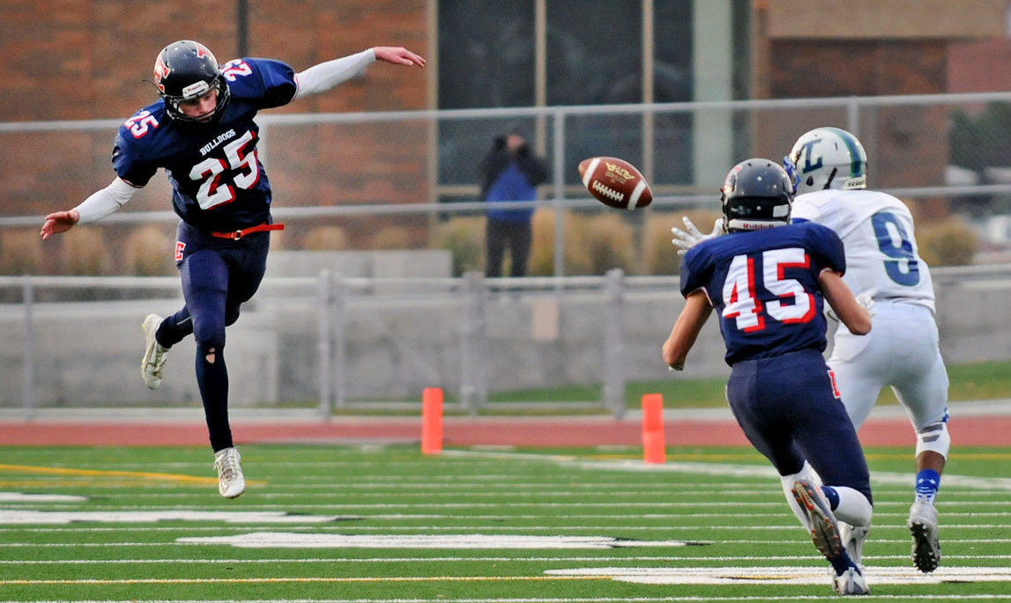
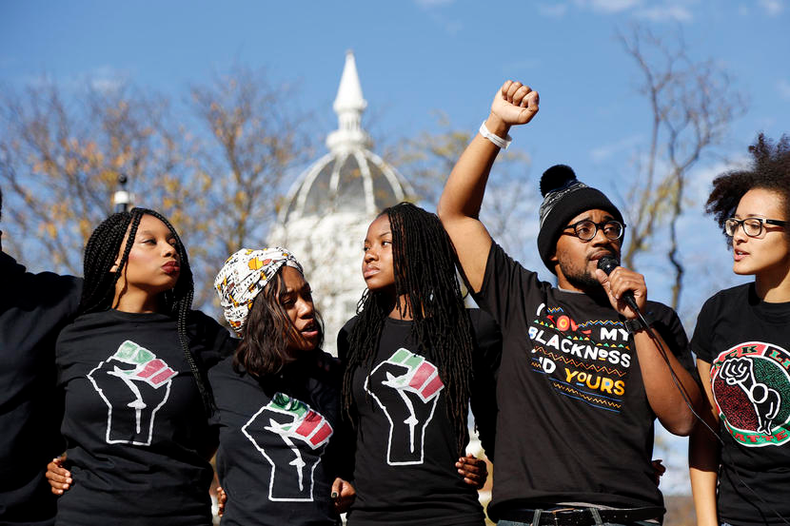
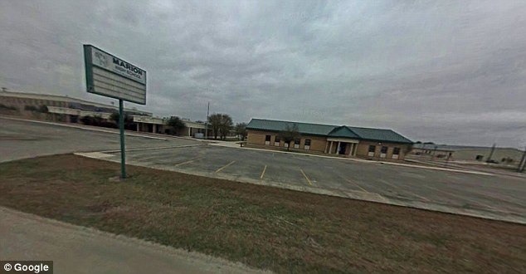
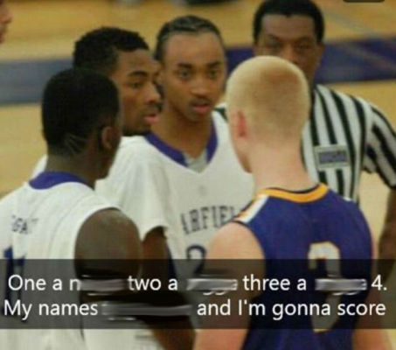

Slide 13
How do we use our understanding of
Impact > Intent
to be more critical readers, writers and thinkers?

